Slide 1
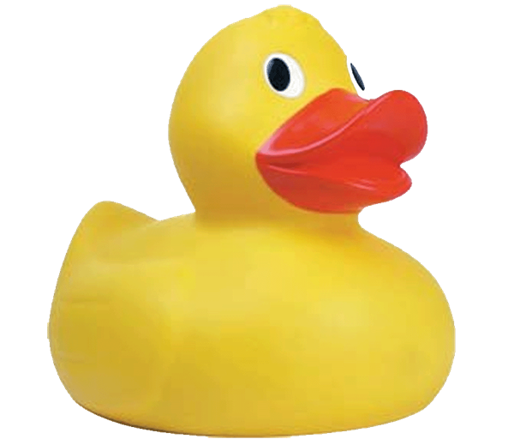
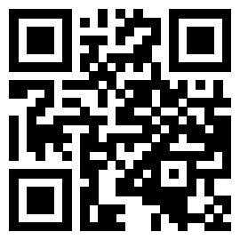

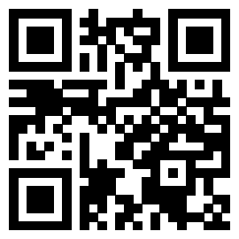
How the
duck
can a machine learn?
Join our Slack:
Sign-in:
go.osu.edu/BDAAsignin
go.osu.edu/bdaaslack
Notes:
Clear kernel & delete ".html" before class
No ducks were harmed in the making of this workshop

Slide 2
Zoom Etiquette & Code of Conduct
Please keep your mic on mute unless talking
Questions are welcome and encouraged at any time! Just please ask in the chat during the presentation
This meeting will be recorded and posted publicly later. By continuing to be in this workshop, you consent to this recording and its publication
BDAA aspires to create a community built on collaboration, innovation, creativity, and belonging within and across disciplines. To inspire, empower, and connect all members -- whatever race, gender, age, ethnicity, cultural heritage or nationality; religious or political beliefs; sexual orientation or gender identity; or socioeconomic, veteran or ability status -- BDAA is committed to an intersectional, persistent, and self-aware movement towards equal opportunity.
By participating in this workshop, you agree to abide by our code of conduct in support of these values (bdaaosu.org/conduct/)

Slide 3
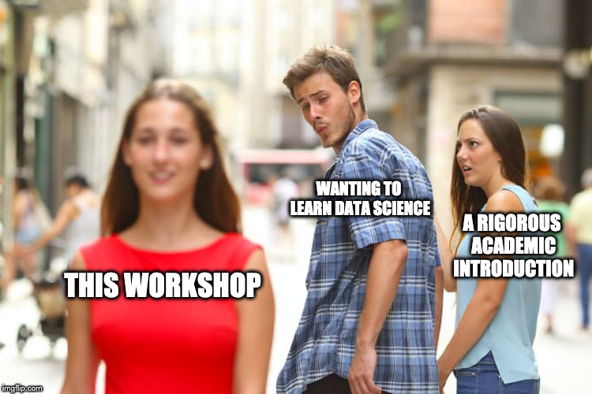
Today We Will...
Learn what Machine Learning is
Do Machine learning on a real dataset
Decision Tree
Random Forest

Slide 4

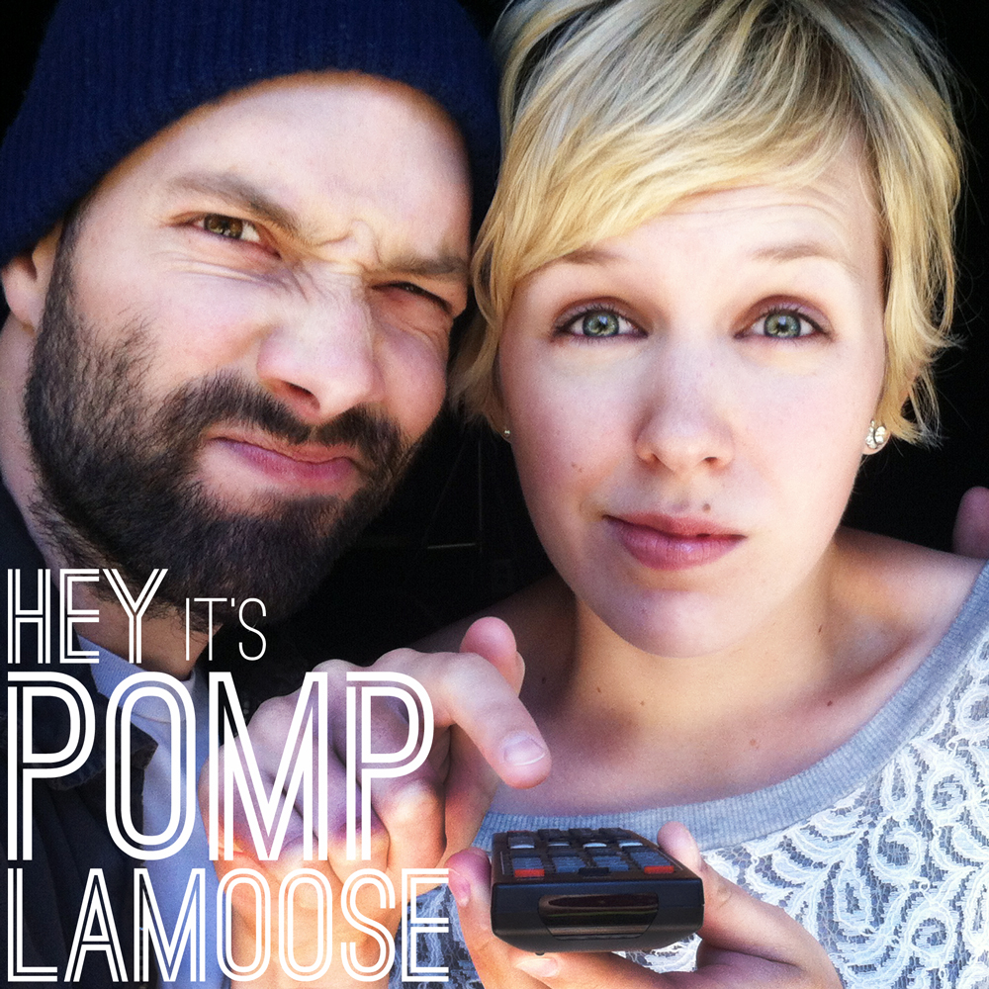
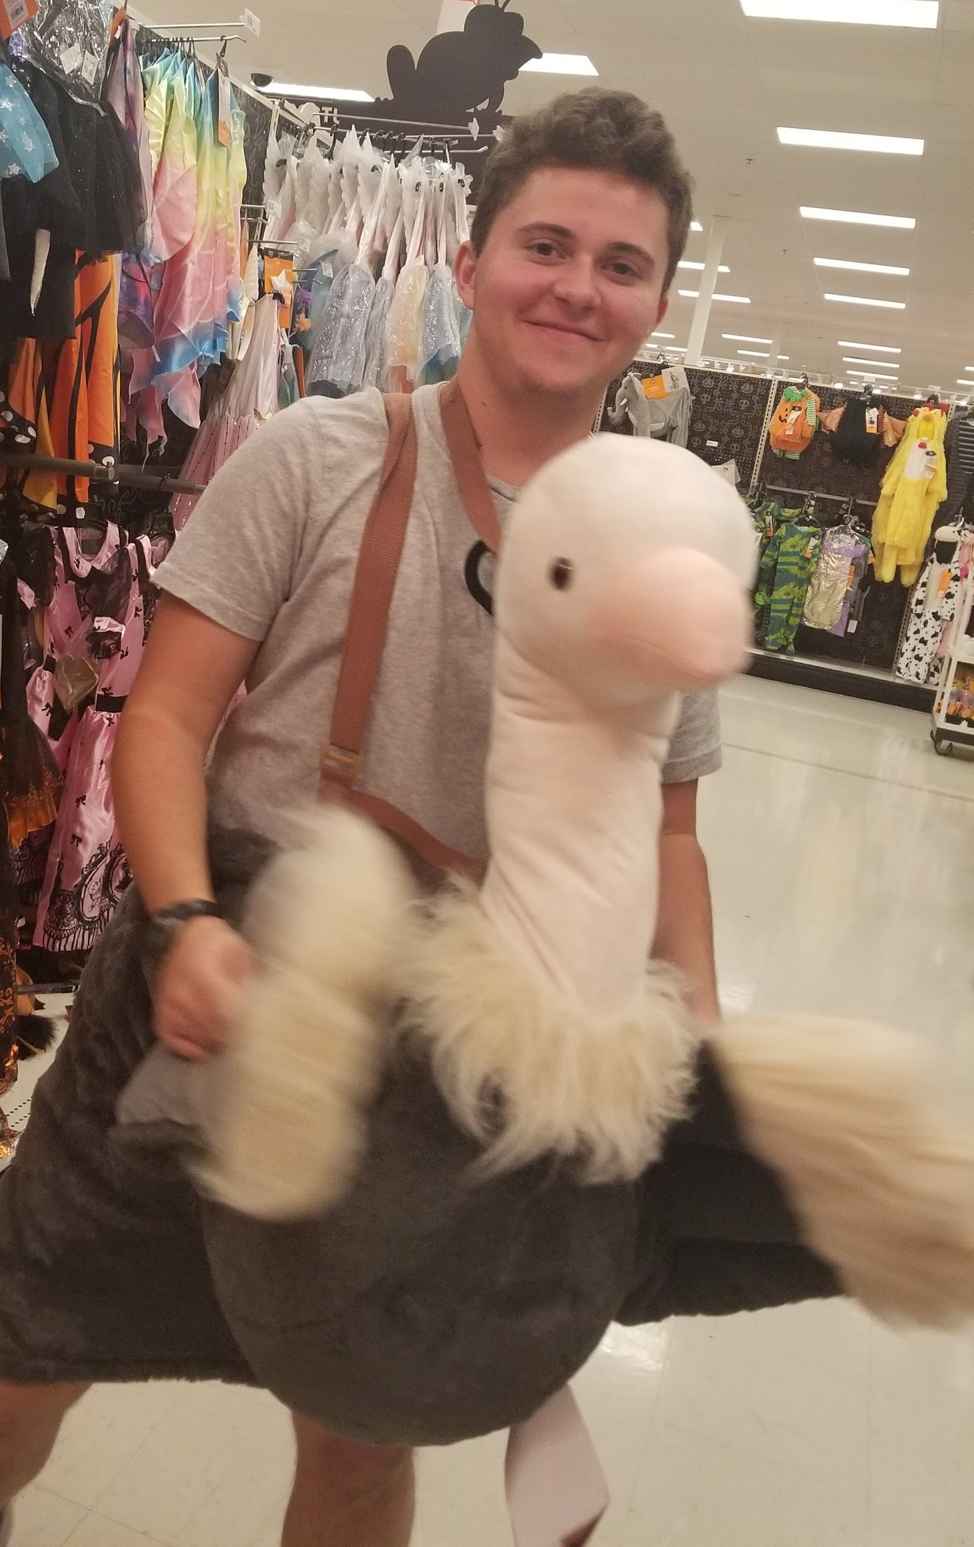
Who am I?
Leo Glowacki (he/him/his)
5th Year
Major: Data Analytics and Music
BDAA Education Director
Certified RStudio Instructor
While walking: Music, sometimes Audiobooks
Recent fav: Pomplamoose

Slide 5
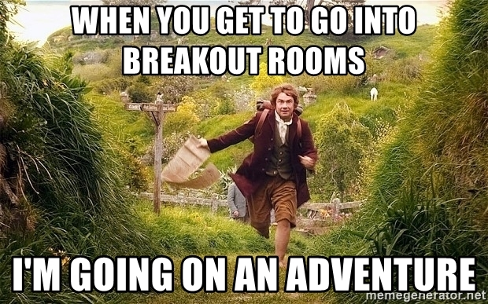
3 Min Intro Breakout Rooms
Name
Major
Year
Where are you from?
While walking: Music, Podcasts, or Audiobooks? (Or something else??)
Recent favorite?

Slide 6
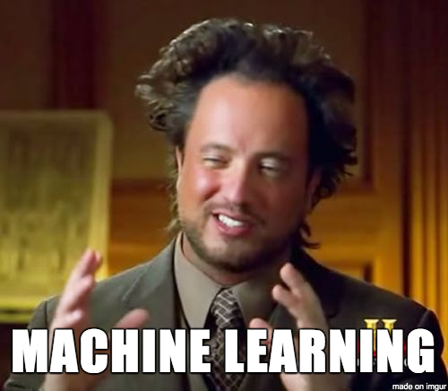
What is Machine Learning (ML)?
Computers "learning" from data
"Machine learning is an application of artificial intelligence (AI) that provides systems the ability to automatically learn and improve from experience without being explicitly programmed."
https://expertsystem.com/machine-learning-definition/

Slide 7

Why use Machine Learning?
You don't have to explicitly program something
ML is powered by data - not instructions
More accurate & easier
When problems are too complex to be explicitly programmed
When the environment changes over time
Notes:
ex: predicting housing prices

Slide 8
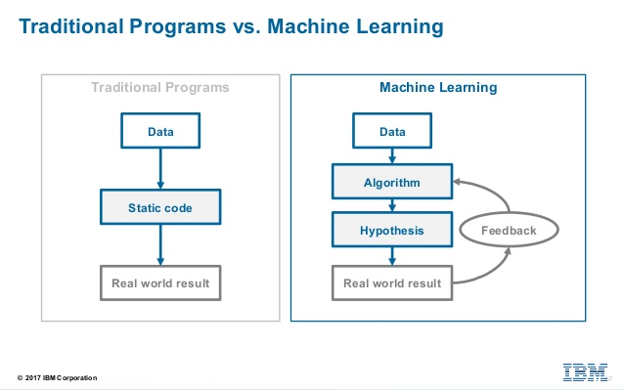

Slide 9
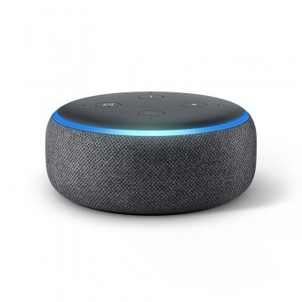

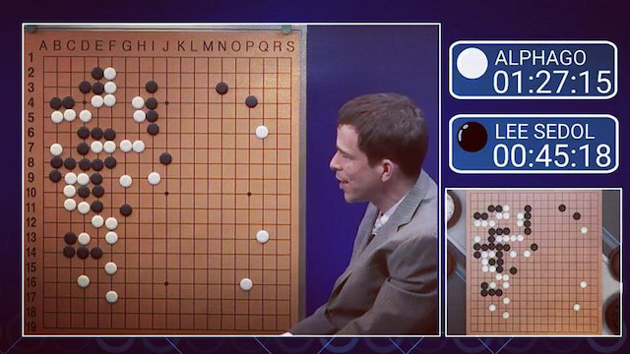

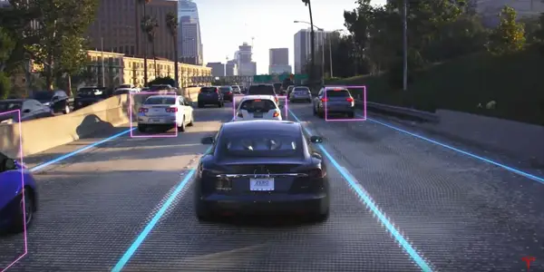
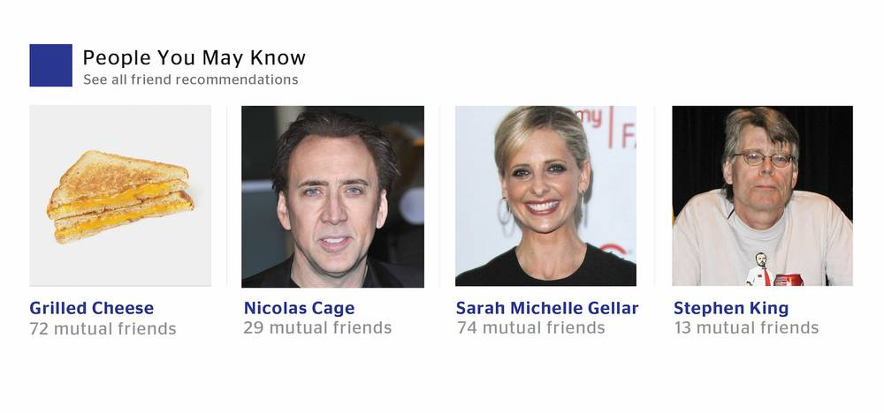
What can ML do?
Notes:
Google DeepMind’s AlphaGo, defeated Lee Sedol, the Go world champion, in 2016

Slide 10
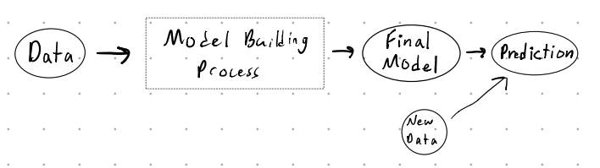
How does ML work?
"If it looks like a duck, swims like a duck, and quacks like a duck, then it probably is a duck."

Slide 11

Q: Is this a duck?

Slide 12
Q: Is this a duck?

Slide 13
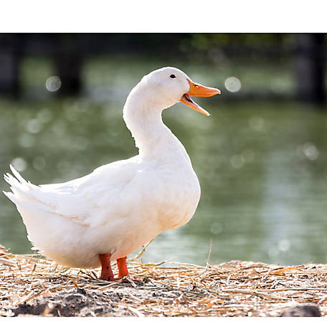
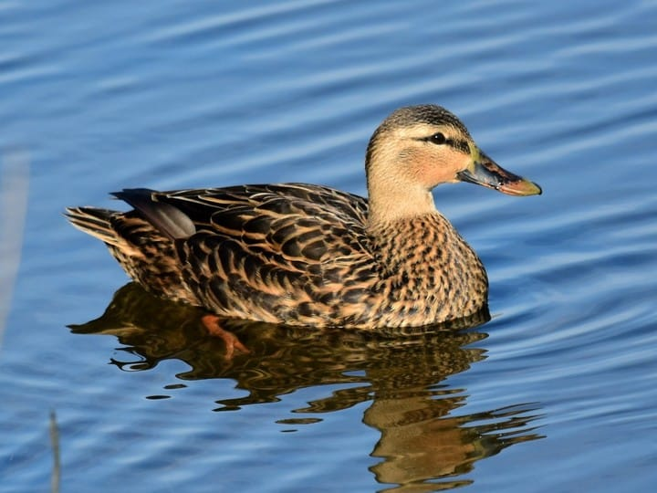
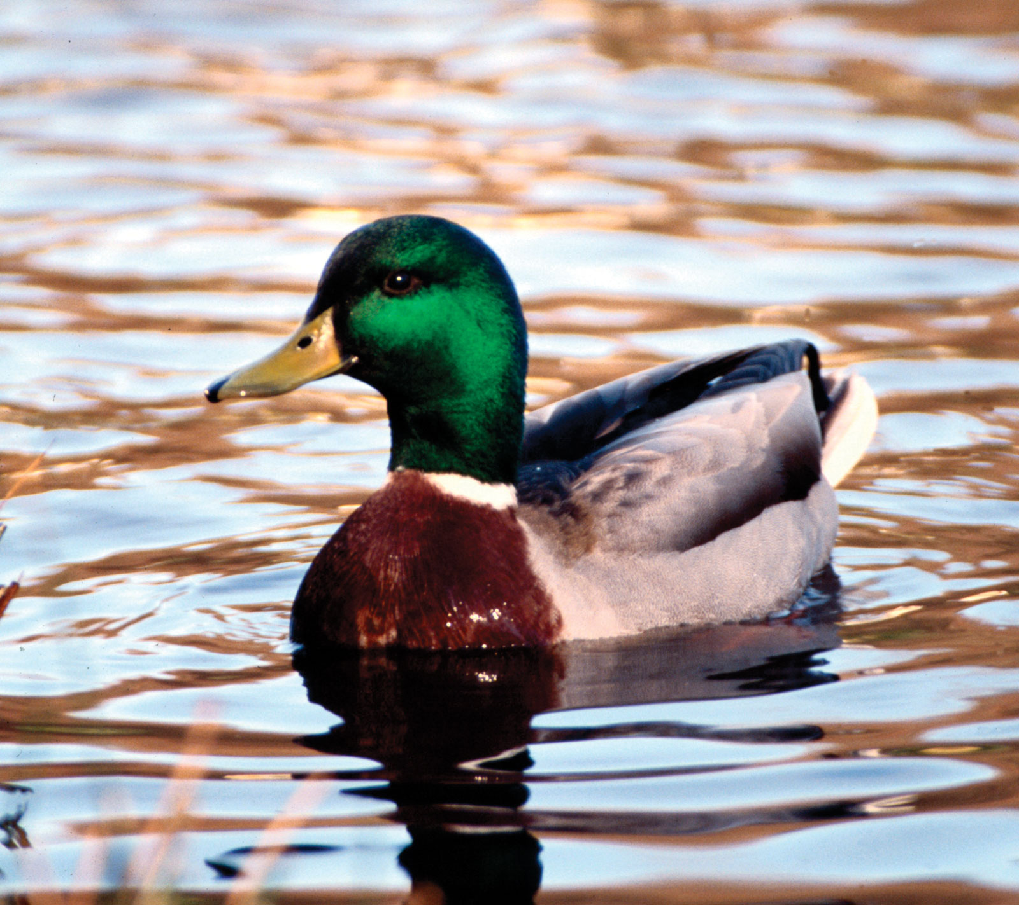
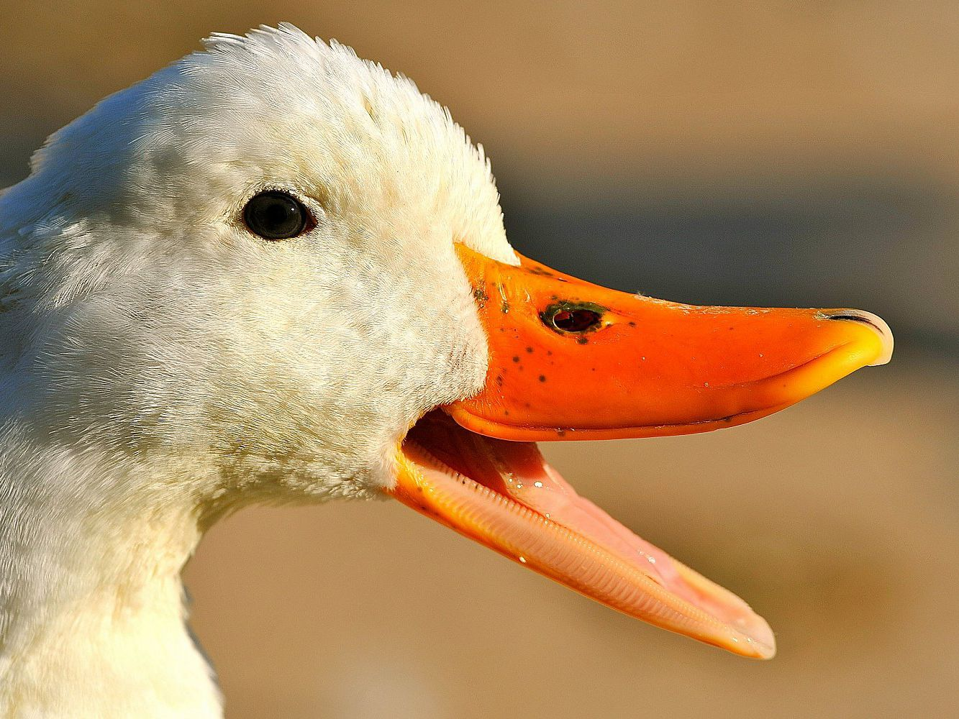
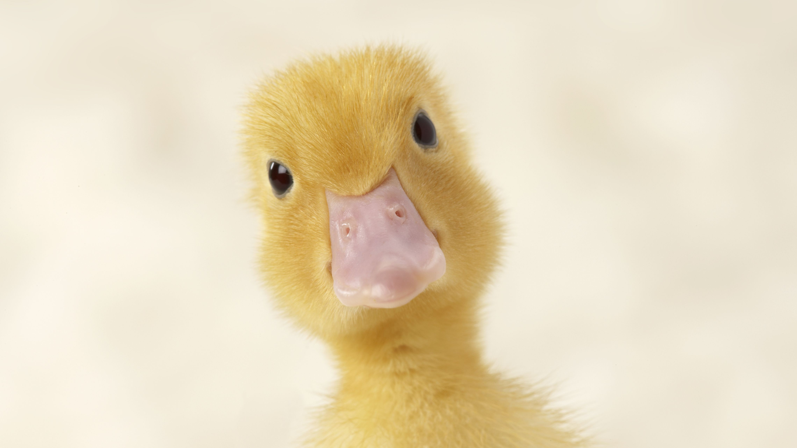
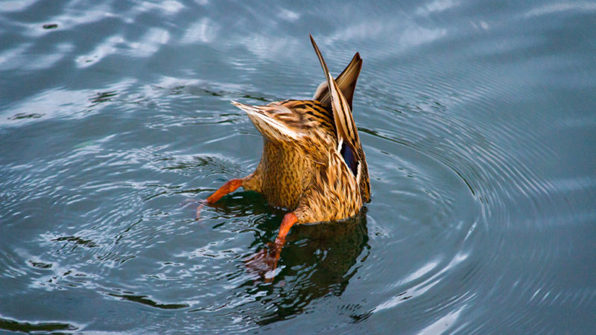
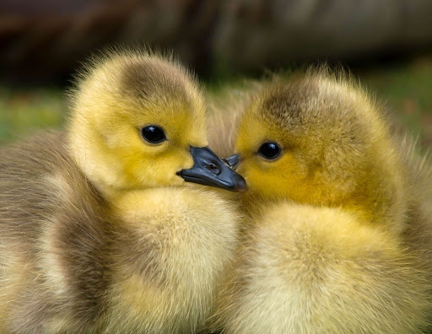
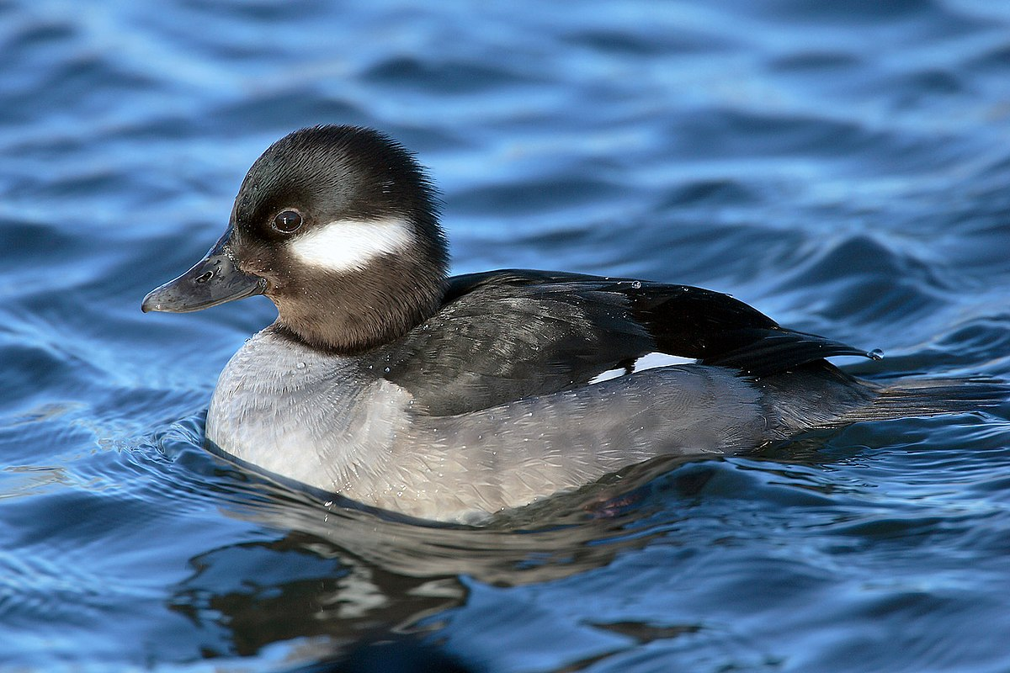
What is a duck?

Slide 14
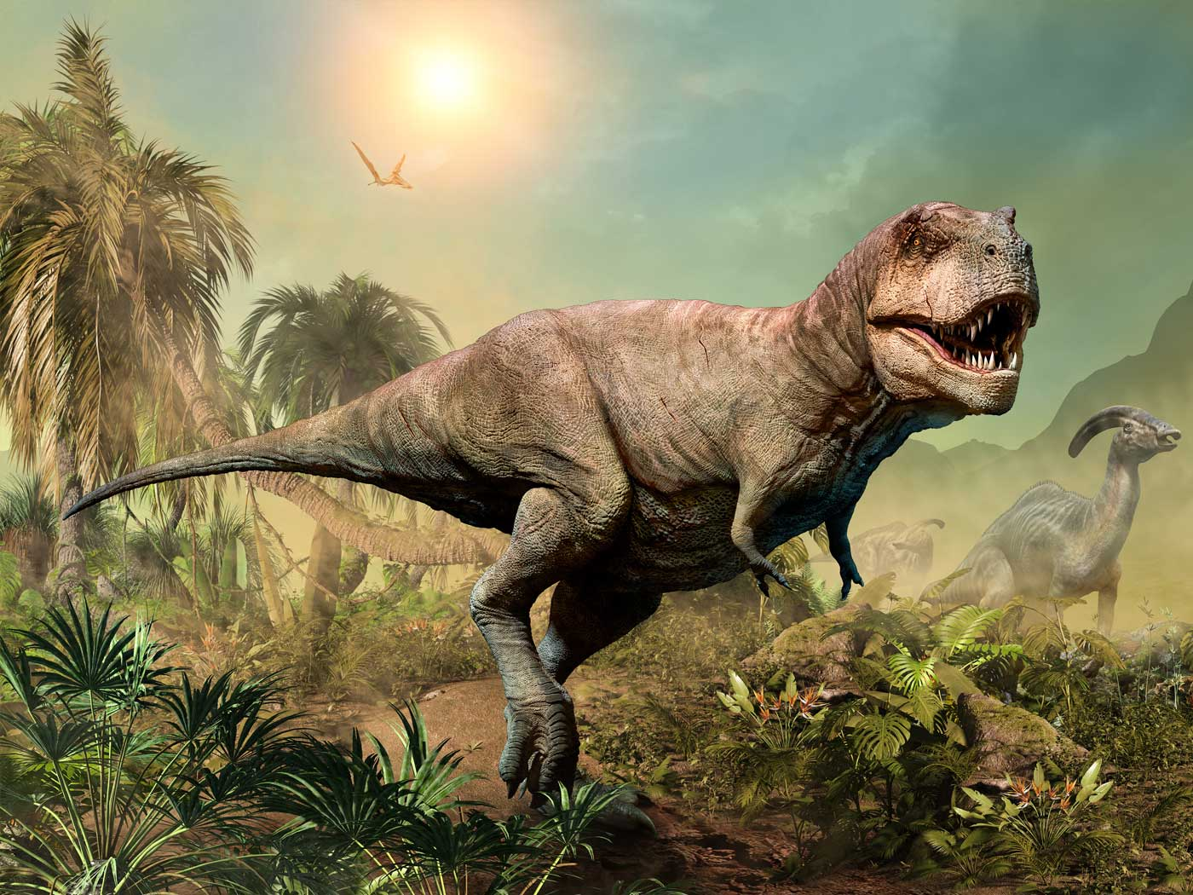
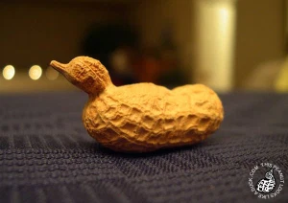
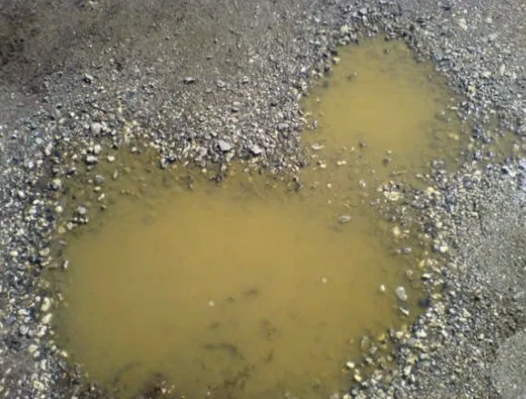
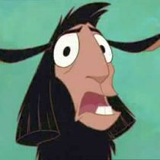
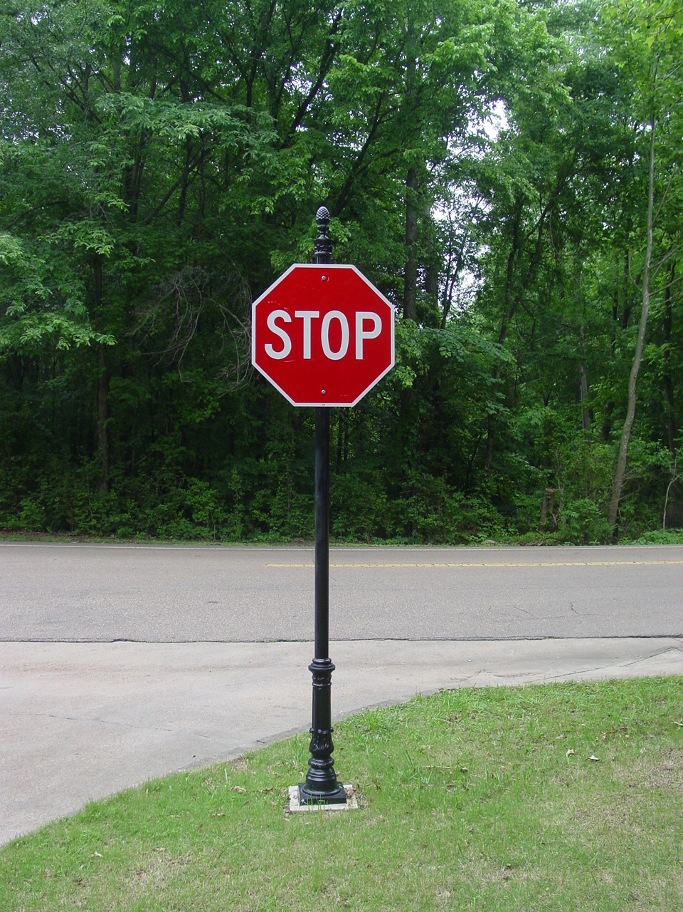

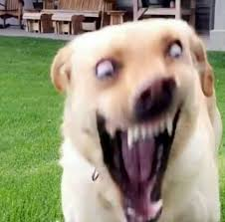
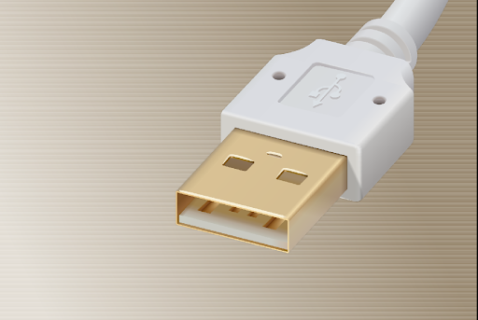
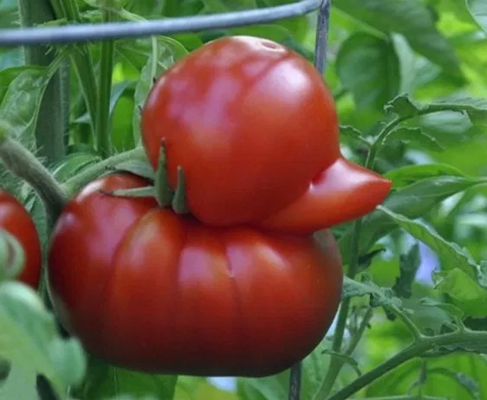
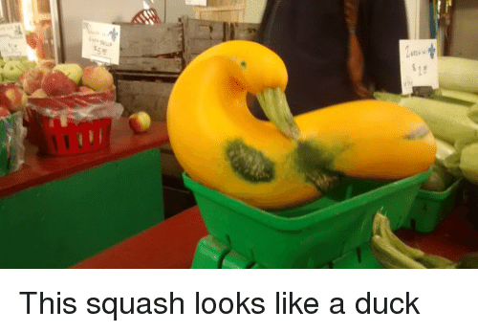
What isn't a duck?

Slide 15
Q: Is this a duck?

Slide 16
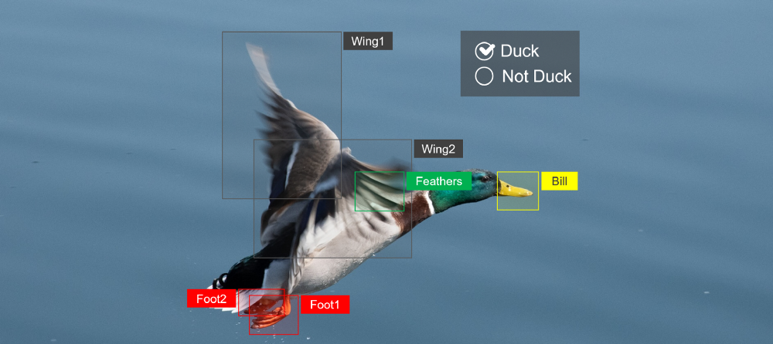
Our Duck Model
Simplified Ex: Ducks have 2 webbed feet, 2 wings with feathers, and a bill

Slide 17
Q: Is this a duck?

Slide 18
Our Prediction
Q: Is this a duck?
A: Yes!
Edited Photo Cred: https://towardsdatascience.com/what-is-ai-38f228d70f5c
(Original Source: Photo by Christian puta on Unsplash)

Slide 19
Q: Is this a duck?

Slide 20
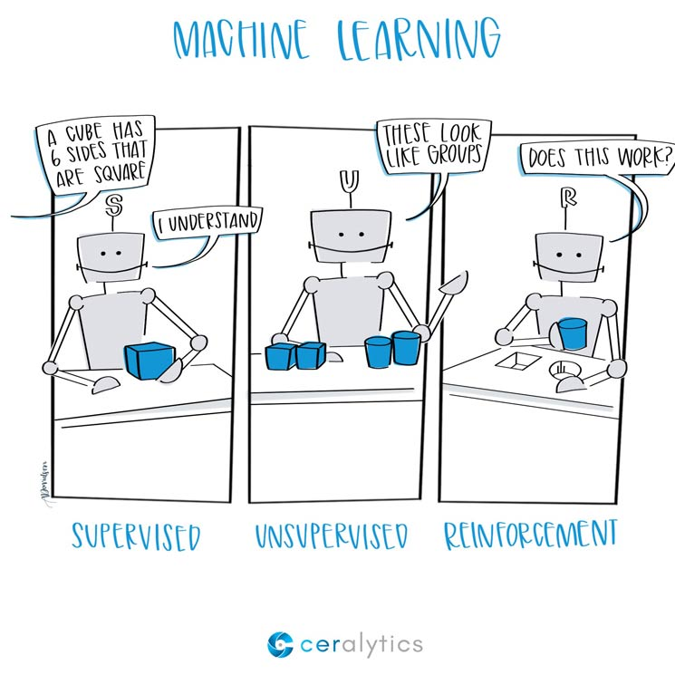
3 Main Types of ML
Supervised
Classifies items or predicts numbers
"This is a duck bc it looks like a duck..."
"Next quarter we will have $10M in profit"
Labeled data
Unsupervised
Groups things together
"These are similar"
Unlabeled data
Reinforcement
Algorithm learns to react to an environment

Slide 21
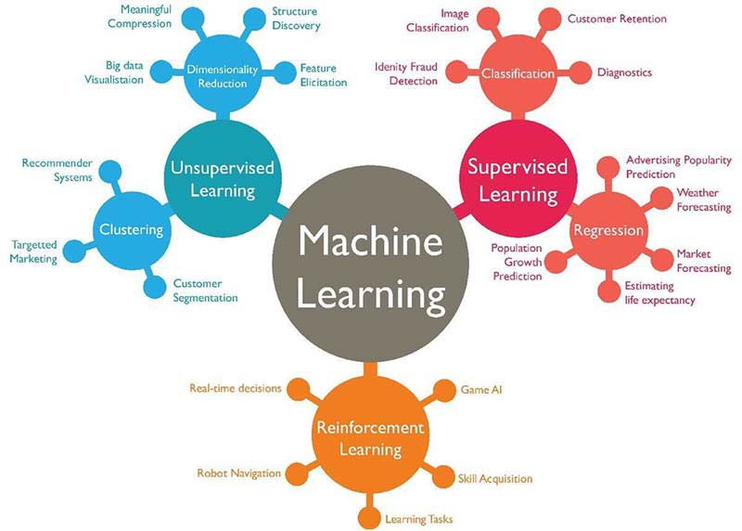

Slide 22
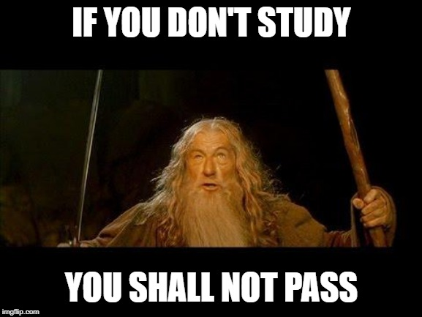
Tonight's Dataset
https://archive.ics.uci.edu/ml/datasets/Student+Performance
Data from 2 public schools in Portugal (2005-2006 school year)
High student failure rates - esp. in Math and Portuguese
Paulo Cortez and Alice Silva
"Using Data Mining to Predict Secondary School Student Performance"
Is it possible to predict student performance?
What are the factors that affect student performance?
Notes:
discuss variables

Slide 23



R, RStudio, & Packages
R is an open source programming language for statistical computing and graphics
RStudio is a free “integrated development environment” (IDE) for R. It is the environment and interface we will be using today to execute our R code.
R packages are a collection of R functions, compiled code and sample data.
Notes:
Packages - “boilerplate” code

Slide 24
Get the R Code
Go to this link: https://go.osu.edu/bdaa_eda_code
Sign in or create account
Join Space
Click "Projects" at the top
Select the "ML Bootcamp" Project
Wait for project to deploy
Select "ML_Workshop.Rmd" (bottom right)
Click "Knit" (top left, blue yarn ball icon)
Notes:
R is a programming language
You can program R in RStudio/RStudio Cloud
Name parts in RStudio
Knitting gets your results
Load times- be patient, don't refresh
Ensure no pop up blockers preventing RMarkdown

Slide 25
Decision Trees

Slide 26
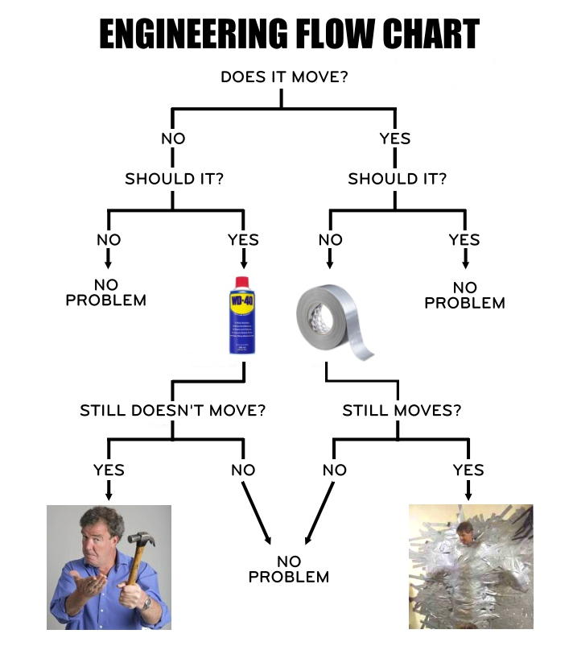
Decision Trees
Type of Supervised Learning
Series of Q's
Versatile: Classification or Regression
Powerful: Can fix complex datasets
"White-box"
Few assumptions about training data
Backbone of Random Forests
reddit.com/r/thegrandtour/comments/5yl6el/engineers_flow_chart/

Slide 27
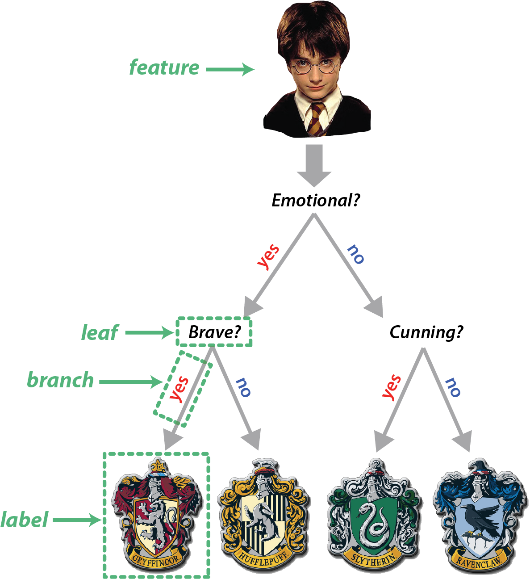
https://medium.com/@tmckenzie.nz/learning-machine-learning-at-hogwarts-55e6ee85eef7

Slide 28

Ensemble Learning
A group of predictors
AKA training more than one model and combing the predictions of them

Slide 29
Random Forests (RF)
Each decision tree in the RF:
has random subset of features
uses random set of the training data points
Final prediction is a majority vote for the predicted class

Slide 30

https://medium.com/@williamkoehrsen/random-forest-simple-explanation-377895a60d2d

Slide 31
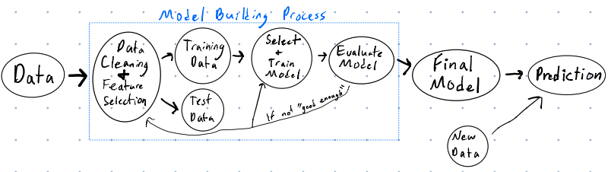
Things we didn't talk about...
Other Supervised ML methods
Unsupervised ML
How to choose the best model
Metrics for evaluating models
Validation, Cross-validation
Model Assumptions & Interpretations
Model Building Process
...

Slide 32
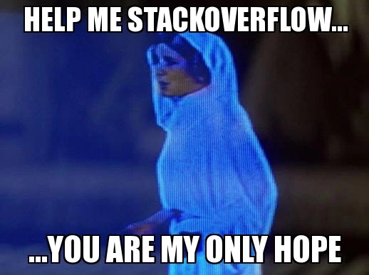
Okay, cool… Now what??
Getting started with R: https://rstudio.cloud/learn/primers
R for Data Science Book: https://r4ds.had.co.nz/
Hands-On ML with R Book: https://bradleyboehmke.github.io/HOML/
The caret Package Book: https://topepo.github.io/caret/index.html

Slide 33
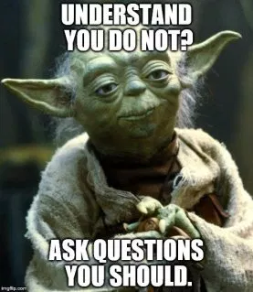
Questions?
Any Questions?
BDAA Slack R Learning Community!
go.osu.edu/bdaaslack
Feedback:
go.osu.edu/bootcamp_feedback
My Contact Info:
Leo Glowacki
Message me on Slack!
www.LeoGlowacki.com

